Slide 1
Rain Forecast in Australia
Group Members:
Eva Chui
Jacky Lee
Shayan Hassan
Notes:
Our project topic is ‘Rain forecast in Australia’

Slide 2

Data set
142193 records with 23 columns
Contains both categorical and numerical variables
Independent variables are:
['Date', 'Location', 'MinTemp', 'MaxTemp', 'Rainfall', 'Evaporation', 'Sunshine', 'WindGustDir', 'WindGustSpeed', 'WindDir9am', 'WindDir3pm', 'WindSpeed9am', 'WindSpeed3pm', 'Humidity9am', 'Humidity3pm', 'Pressure9am', 'Pressure3pm', 'Cloud9am', 'Cloud3pm', 'Temp9am', 'Temp3pm', 'RainToday']
Target variable is 'RainTomorrow'
Notes:
The aims of using this data set is predict the weather of Australia
There are 142193 data with 23 columns
It contains both categorical and numerical variables
We use these independent variables to forecast whether it will rain tomorrow.
For the column ‘Date’, we change the datatype from object to datetime and extract the month to ‘Month’ column, it convenient for us to do the analysis later
The target variable ‘RainTomorrow’ contains YES and NO

Slide 3
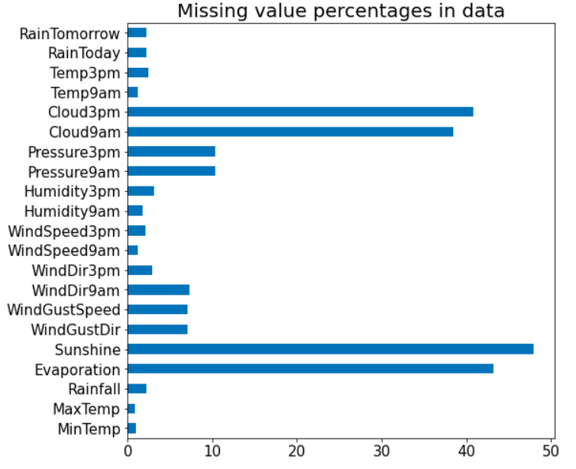
EDA
Many columns have missing values.
>30% missing:
Evaporation
Sunshine
Cloud9am
Cloud3pm
Notes:
This graph shows the percentage of missing data for each column
We found that there are many columns have missing values, some of them have a high percentage
These four columns have more than 30% of missing values
We will talk about how to clean the missing values later

Slide 4
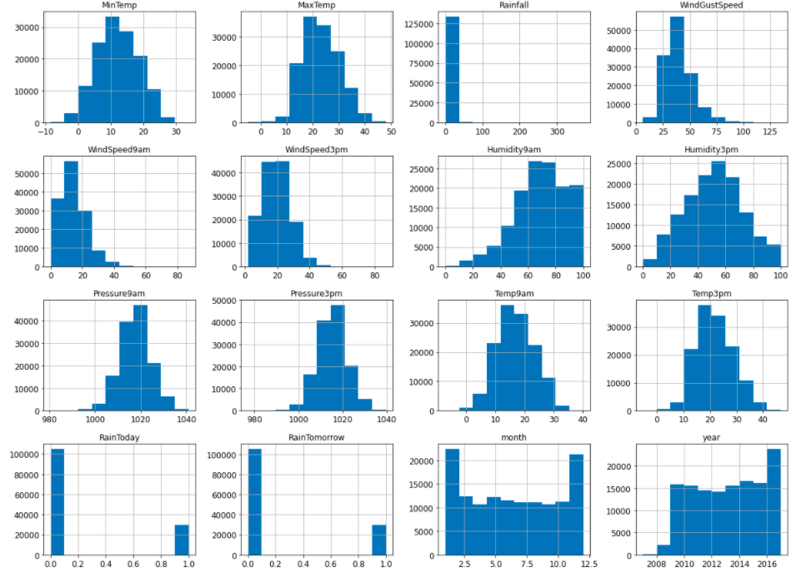
Notes:
This graph shows the distribution for each feature
We can see the value count of target ‘RainTomorrow’
Most of them are normal distribution

Slide 5
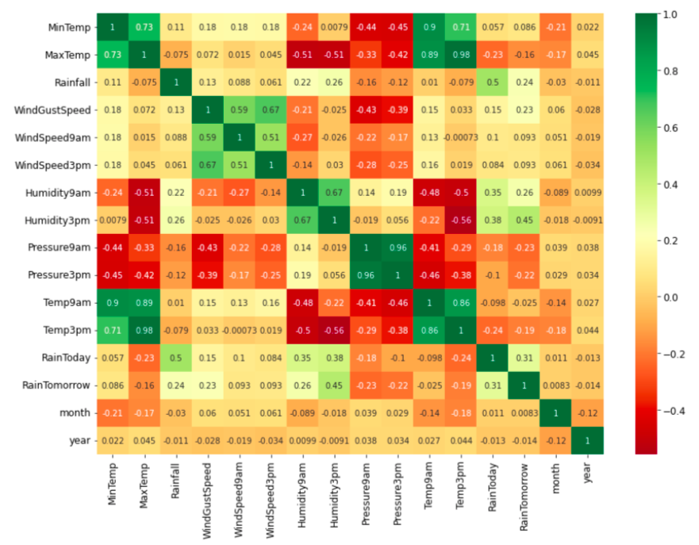
Notes:
This is a heatmap shows the correlation between the variables
The green one and the red one mean there is a high correlation between two variables
We chose three of them which have correlation larger than 0.9 and deal with them in the data cleaning part

Slide 6
Data cleaning
Convert categorical variables to numerical using one-hot encoding in both dataset
Remove columns with more than 30% missing values
Dataset A
Handling Missing values:
Categorical data: Fill na with mode by month
Numerical data: Fill na with median by month
Removing correlated features:
Temp9am
Temp3pm
Pressure3pm
Dataset B
Delete rows where value is missing
Notes:
For the part data cleaning, we tried two different methods, to compare which cleaned dataset has a higher accuracy rate in machine learning model
The same things we did in the both dataset are ‘convert categorical variables to numerical using one hot encoding’ and remove columns with more 30% missing values
After that we did different things in both dataset. The first method we did in dataset is fill na with mode by month on categorical data and for the numerical data, we fill with mean
then , we removed the features I mentioned in the previous slide ,which have high correlation
For the second method, we just delete rows where value is missing

Slide 7
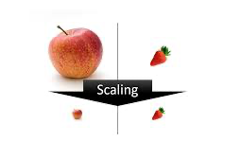
Feature Scaling
DataSet - A
Standard Scaler
DataSet - B
MinMax Scaler
Notes:
The feature scaling we did in dataset A is Standard Scaler and MinMax Scaler for dataset B

Slide 8
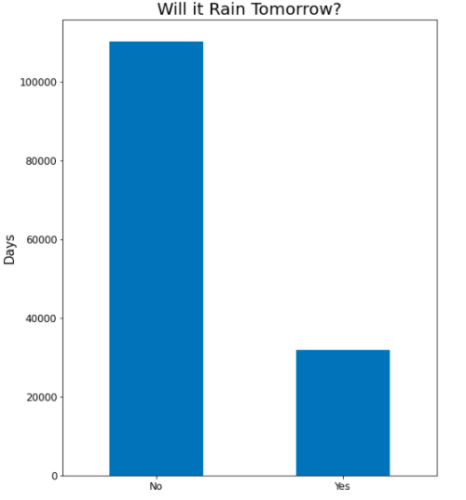
Balancing the data
SMOTEENN
Upsampling
Downsampling
Dataset A → Upsampling
DataFrame B → SMOTENN
Notes:
The data is imbalance which can be seen from the value count distribution plot.
We tried various techniques to balance our dataset using SMOTENN, Upsampling and Downsampling. Each of the techniques offered different accuracies and performance levels for various machine learning models that we tried as will be discussed in our presentation later.

Slide 9

Model used
Logistic regression
KNN
SVM
Decision Tree
Random Forest
AdaBoost
XGBoost
Notes:
We tried various Machine Learning models on our dataset

Slide 10
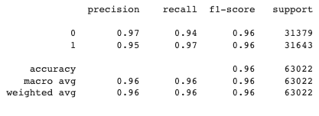
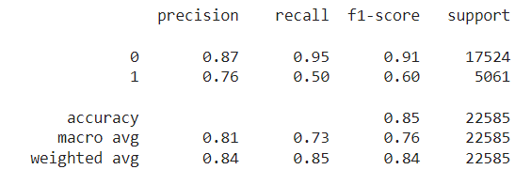
Model results
Dataset A:
96% accuracy achieved on Randomforest
Dataset B:
85% accuracy on XGBoost

Slide 11
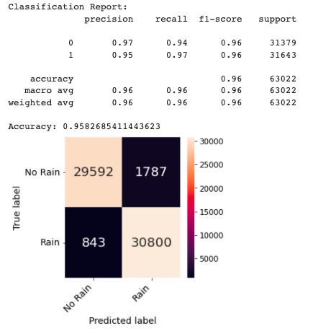
Model fine tuning on dataset A
GridSearchCV for HPO on RandomForest
PCA for dimensionality reduction with 0.95 variance provide decent results.
Accuracy: 0.9361810161530894

Slide 12
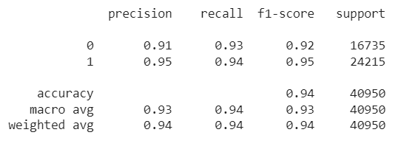
Model fine tuning on dataset B
RandomizedSearchCV
pca = PCA(0.95)
Accuracy: 0.91142857

Slide 13
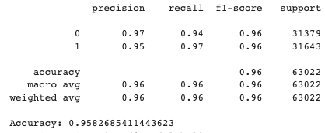
Final Model
DataSet A (Random Forest)
Applied GridSearchCV for HPO
Accuracy is not much improved.
Dataset B (XGBoost)
Applied RandomSearchCV for HPO
Accuracy is improved.

Slide 14
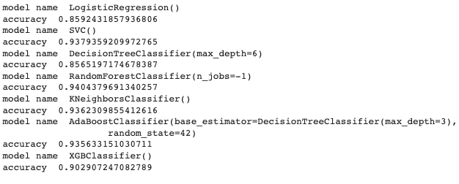
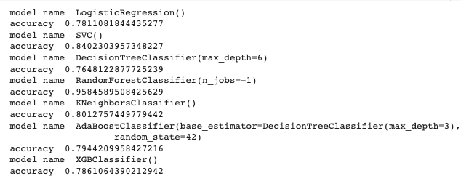
Accuracies on SMOTENN dataset A
Accuracies on Upsampled dataset A

Slide 15
Conclusion and Future Improvements
Data cleaning method affects final model accuracy
Filling missing values
Balancing techniques
Processing time
Build a better pipeline

